Slide 1
Baltimore City Crime forecasting
By Demarcus Wirsing

Slide 2
Introduction to Baltimore City
Population: 609,841
7th. Most dangerous City in the United States
6 Districts.

Slide 3
Gathering the data
I will be using the following data sources to forecast the criminal activity with in Baltimore City.
https://data.world/
https://data.baltimorecity.gov/

Slide 4
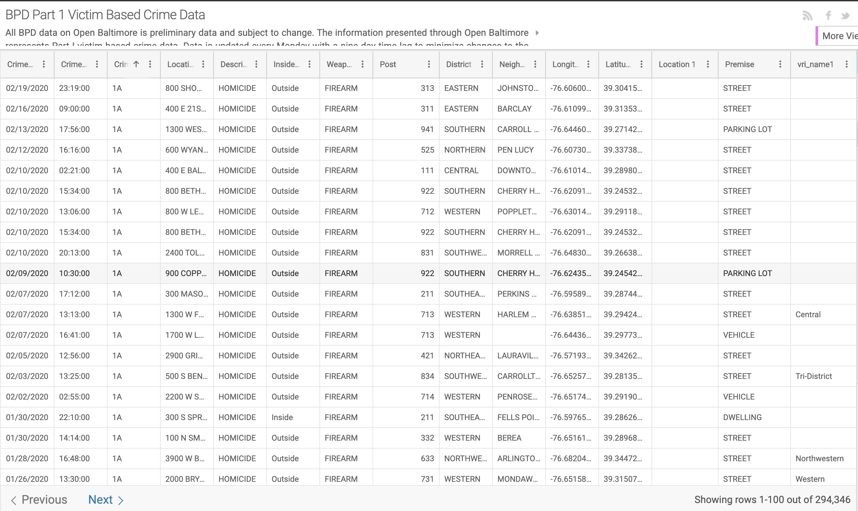
Peek at the data

Slide 5
Questions From looking at the data set
From the data set I want to predict which district will crime spike or lower based on the information provided.
Why is crime so high in these areas.
What can we do from looking at the data to decrease or try to decrease crime in these areas in Baltimore City.
Can I predict or forecast based on the data what the crime activity will look like one year or two years from now.

Slide 6
Any Questions ?

